Slide 1


Slide 2
PRESENTERS:
Neil O’Flaherty-Principal and
Class of 1987
Susan Spellman Cann-
Coordinating Teacher-Counselling

Slide 3
BCHS VIDEO

Slide 4

FOOTPRINTS ACTIVITY

Slide 5
QUICK FACTS
Established 1971
NAASP Model Schools Program
“A School for Everyone”—
J. Lloyd Trump
Canadian Coalition for
Self Directed Learning
(8 schools in Canada)
Current Enrolment-1249 students

Slide 6

2014-15 VISITS, TOURS &
CONNECTIONS

Slide 7
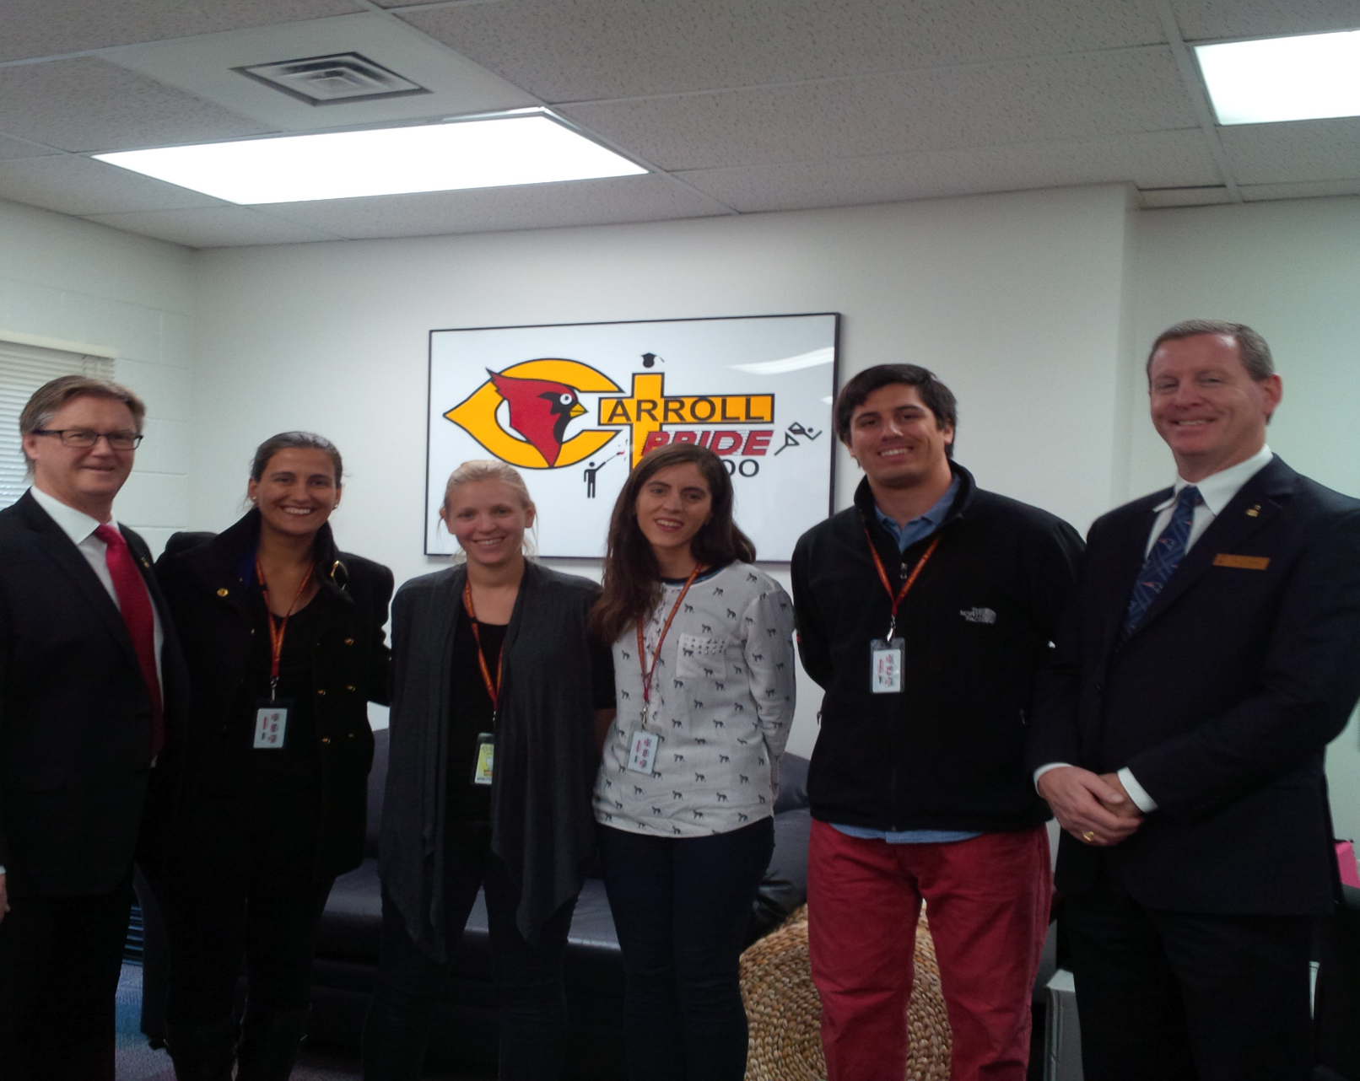
EDUCATORS FROM CHILE- FEBRUARY 2015

Slide 8


Slide 9

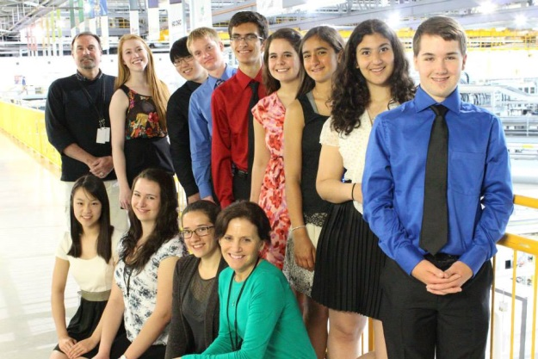

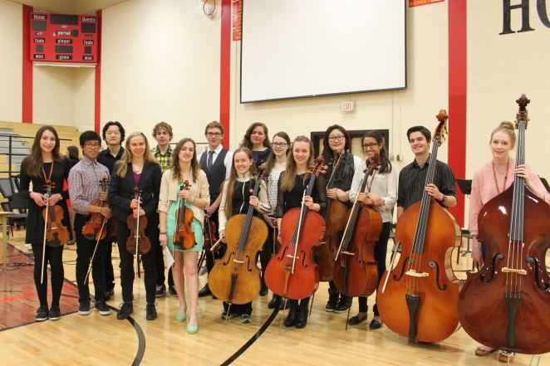
9 FOUNDATIONAL PRINCIPLES OF
HIGH SCHOOL RE-DESIGN
Mastery Learning
Personalization
Flexible Learning Environments
Home and Community Involvement
Assessment
Meaningful Relationships
Rigourous and Relevant Curriculum
Educator Roles and Professional Development
Welcoming, Caring, Respectful and Safe

Slide 10
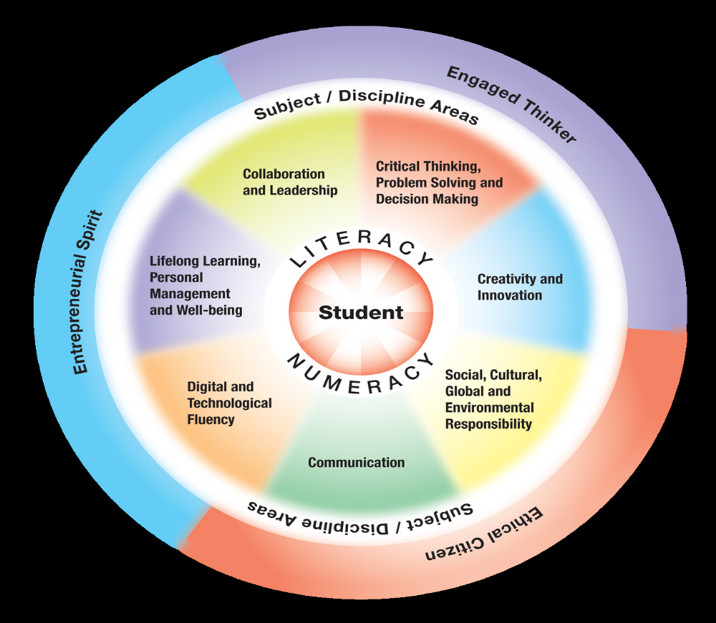
FRAMEWORK FOR
STUDENT LEARING

Slide 11

≠
SELF DIRECTED
ON MY OWN
Guided and Supported

Slide 12
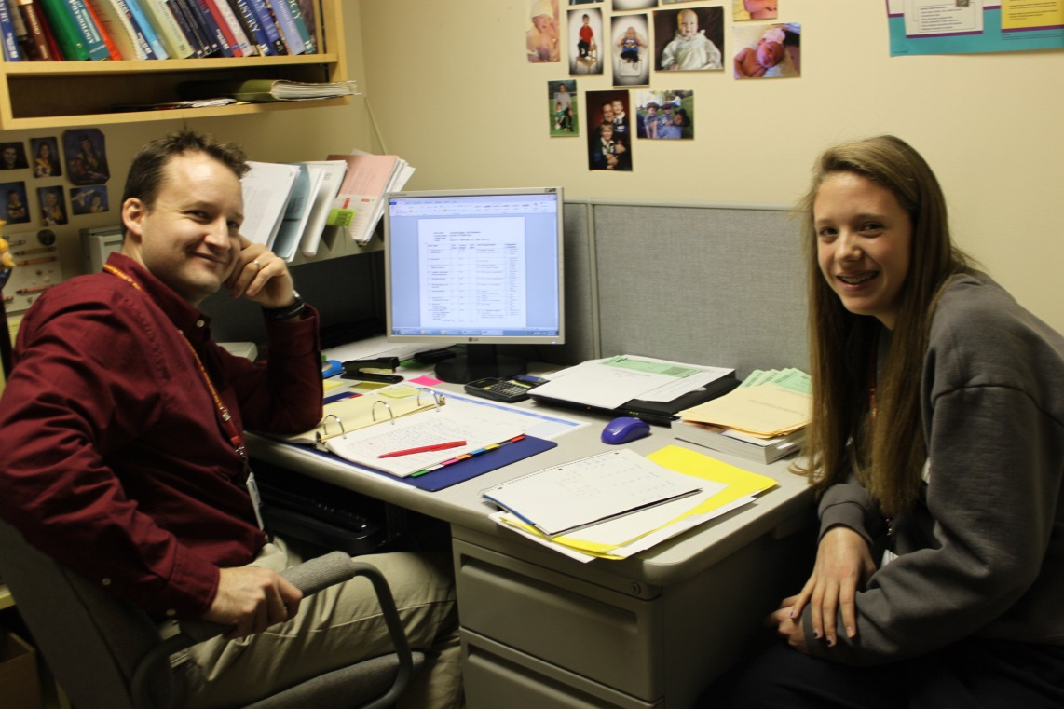
TEACHER ADVISOR
Supported Learning and School Life
Independence
Autonomy
Choice

Slide 13
WHAT ARE POST-SECONDARY AND
EMPLOYERS SEEKING?
AUTONOMY
Desire to be self-directed
MASTERY
The urge to get better at tasks
PURPOSE
Making a contribution (to society)
You Tube RSA Animate Dan Pink Motivation

Slide 14

TRADITIONALMODEL
Ten bells
75-80 minute classes
Pre-determined:
- lunch- tests- assignments
One teacher to 36-40 students
Must remain in class even if work is completed
Carnegie Unit/Model
4-80 minute blocks x 5 days/week
1 credit = 25 hours of class-time
3 credit = 75 hours
5 credit = 125 hours
Teacher-oriented approach
WHAT IS SELF-DIRECTION?
≠
SELF DIRECTED
ON MY OWN
Independence
Autonomy
Choice

Slide 15
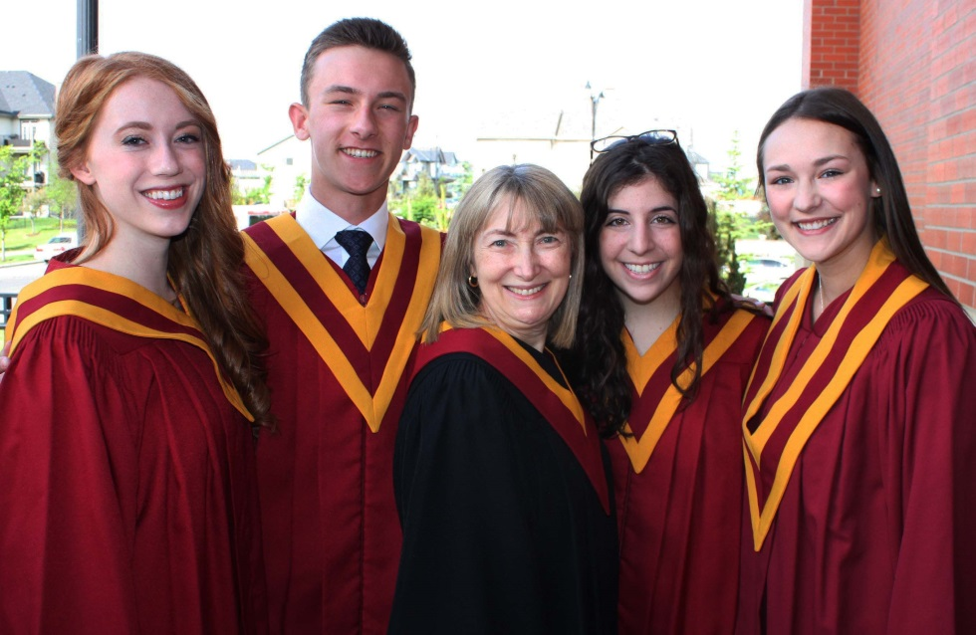
BISHOP CARROLL
Three bells
One-to-one support
Seminars (small group)
Collaborative group work
Learning Guide-gets you started
Seminar (6-30 students group work;)
Second seminar or summative evaluation
Common Testing Centre
You determine when you are ready -to be assessed
Your choice of what you work on and where you work
Student-Oriented approach

Slide 16
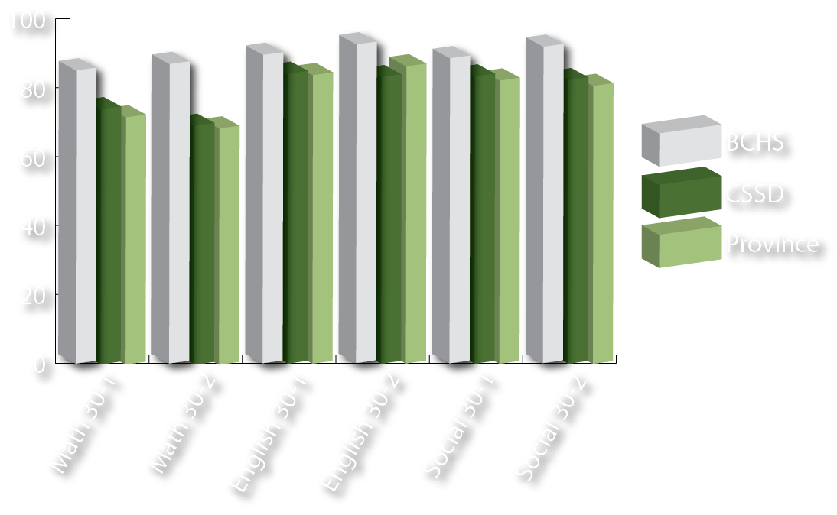
BISHOP CARROLL ACADEMICS
DIPLOMA EXAM RESULTS 2014 – Acceptable Standard Percentage

Slide 17

BISHOP CARROLL ACADEMICS
DIPLOMA EXAM RESULTS 2014 – Acceptable Standard Percentage

Slide 18
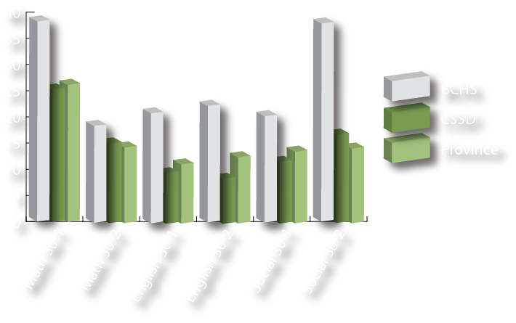
BISHOP CARROLL ACADEMICS
DIPLOMA EXAM RESULTS 2014 – Excellence Percentage

Slide 19
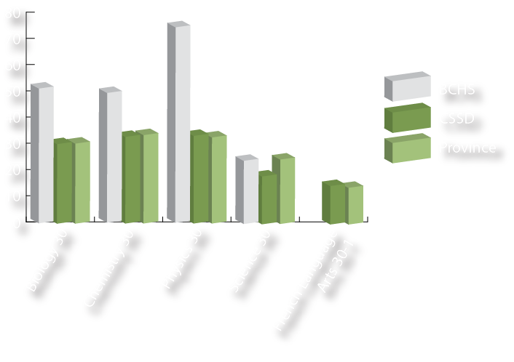
BISHOP CARROLL ACADEMICS
DIPLOMA EXAM RESULTS 2014 – Excellence Percentage

Slide 20

SYNCHROTRON-
Canadian Light Source-Saskatoon 2014
INTERNATIONAL SPACE STATION-FALL 2015

Slide 21
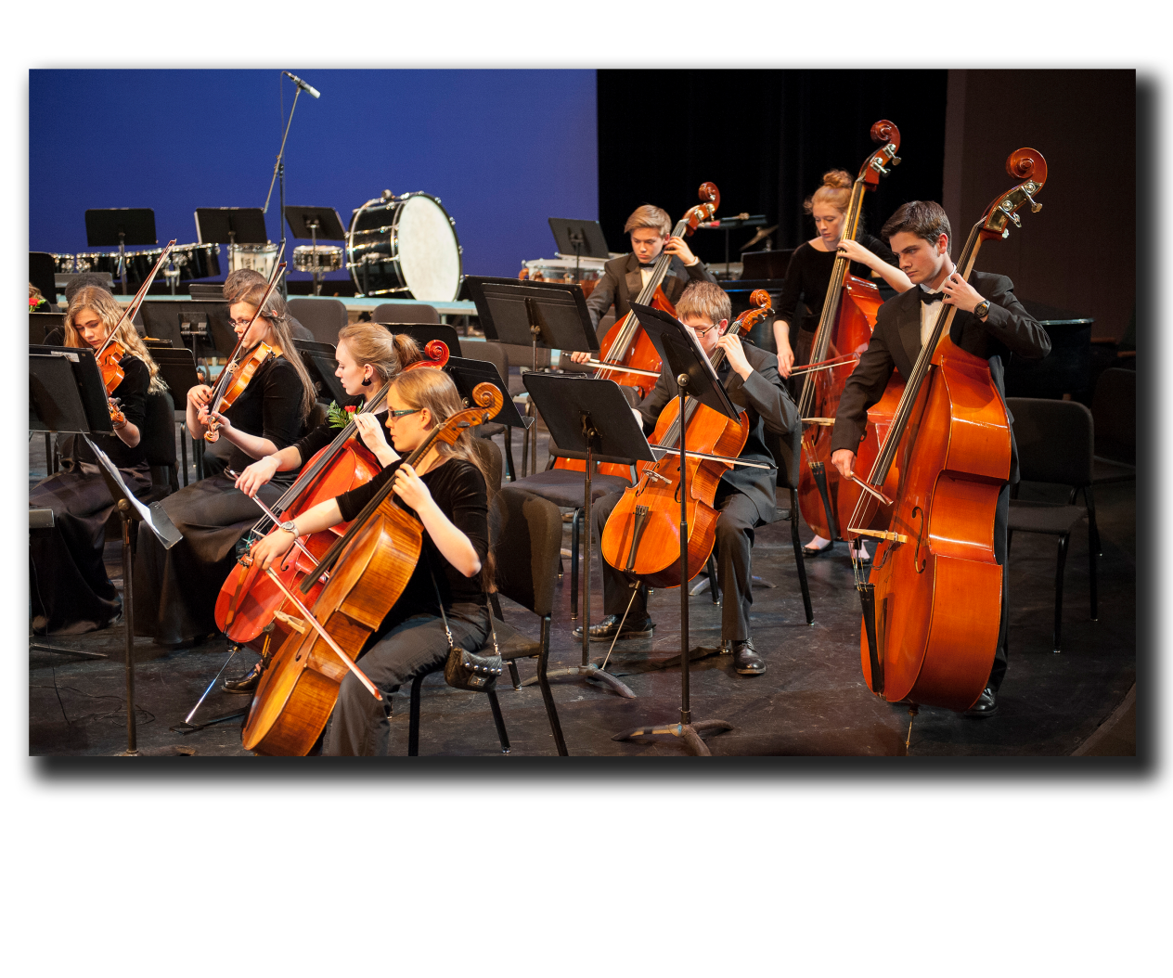
COMPLEMENTARY COURSES
Art
Drama
Photography
International Languages
Health, Fitness, & Recreation
Entrepreneurialship and Investment
Choral Music, Concert Band, Strings

Slide 22


Slide 23
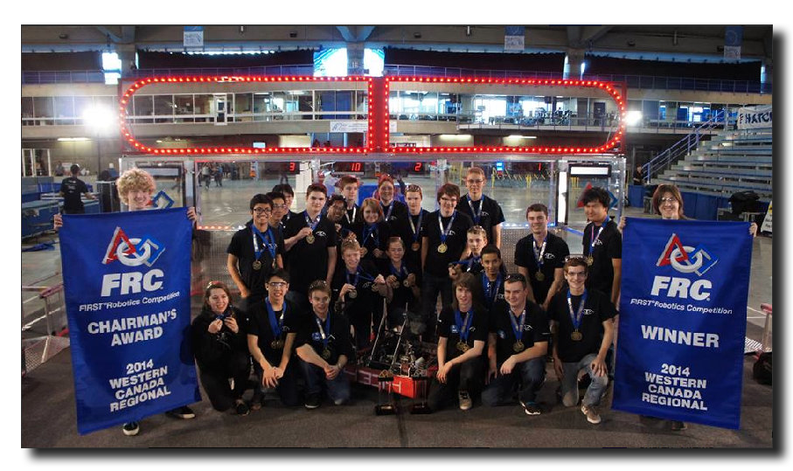
COMPLEMENTARY COURSES
Digital Media
Construction
Cosmetology
Robotics
Jazz Choir & Jazz Band
Community & Volunteerism
Microsoft IT Academy & Adobe Certification

Slide 24
CLUBS & COMMITTEES
Student Council
Eco-Council
Art
Y4J (Social Justice Group)
Youth Alpha (Faith Group)
Improv (Drama)
Anime (Drawing)
Chess and Games
Hands and Feet of Bishop Carroll
Youth Volunteer Corps
Robotics
Healthy Relationships
Linkages
Speech & Debate
French
Spanish
Japanese (Unique)
Intramurals
Carroll Chronicle
Music Council
Book Club
Encounters
Mental Health
Yearbook

Slide 25
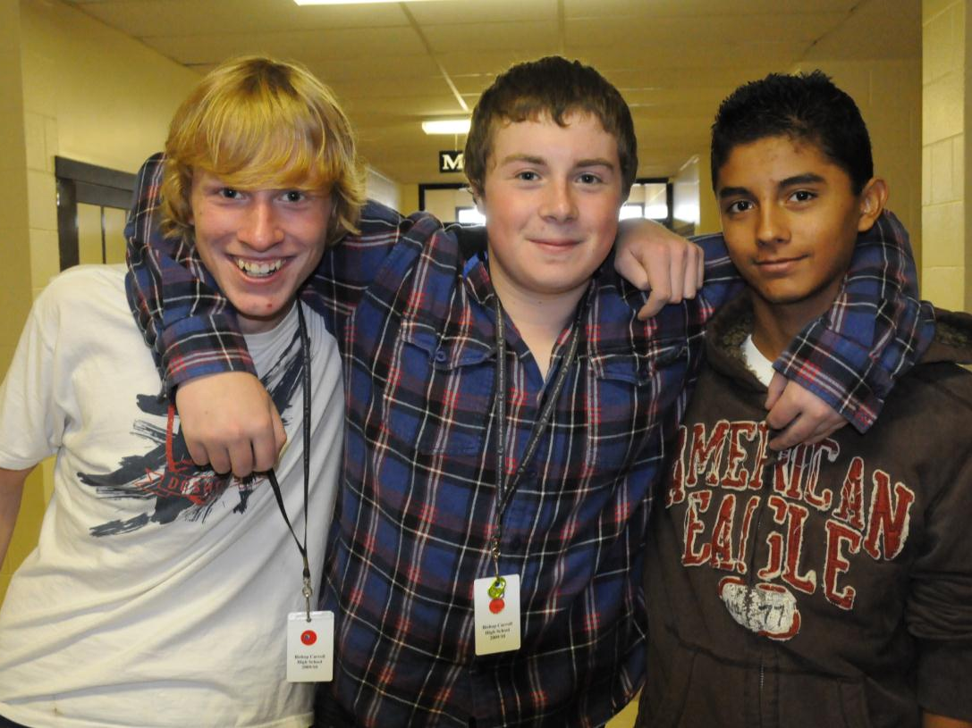
ACADEMIC SUPPORT
Student Services, Career Centre & Academic Resource Centre

Slide 26

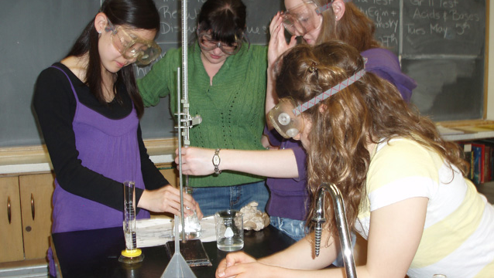
ADVANCED PLACEMENT

Slide 27


Slide 28


Slide 29
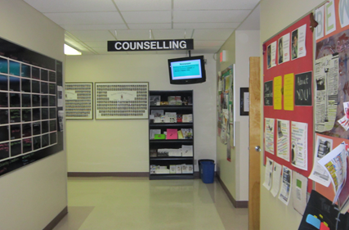
Susan’s
Presentation

Slide 30
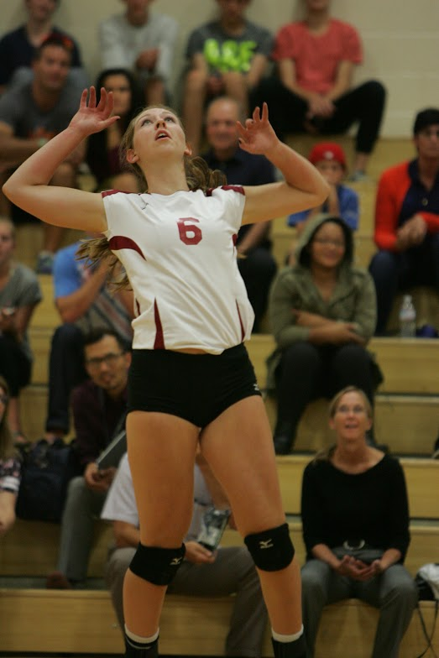
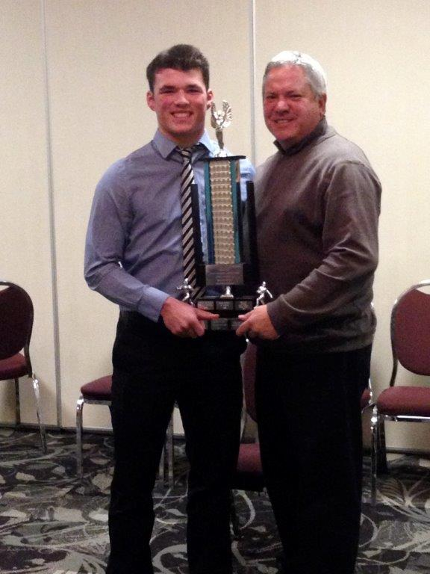
ATHLETICS
HOME OF THE CARDINALS

Slide 31

Functional Toolbox for
Self-Directed Learning
Learning Guide
Tracking Sheet
Master Seminar Schedule
Common Testing Centre
Embedded PD

Slide 32
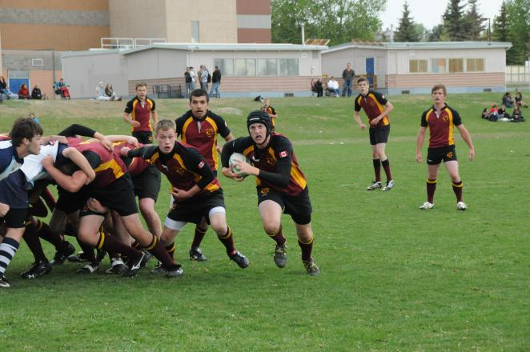
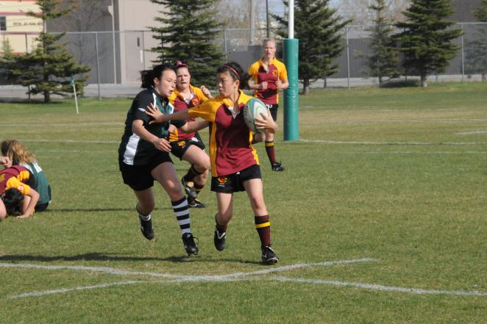
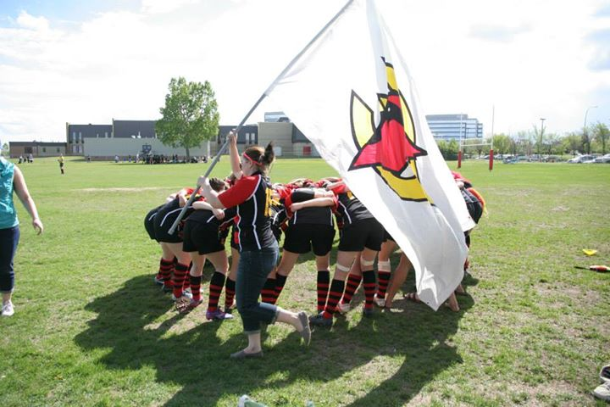
RUGBY
NEW ZEALAND MARCH 2015

Slide 33


PHYSICAL EDUCATION
HEALTH FITNESS RECREATION

Slide 34
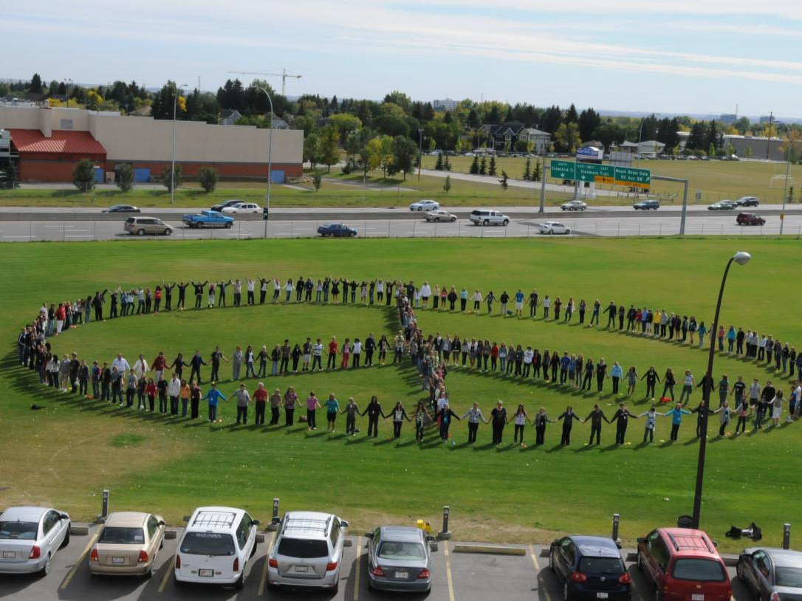
Youth Alpha
Youth Volunteer Corps
Linkages (with Seniors)
Youth For Justice (Y4J)

Slide 35

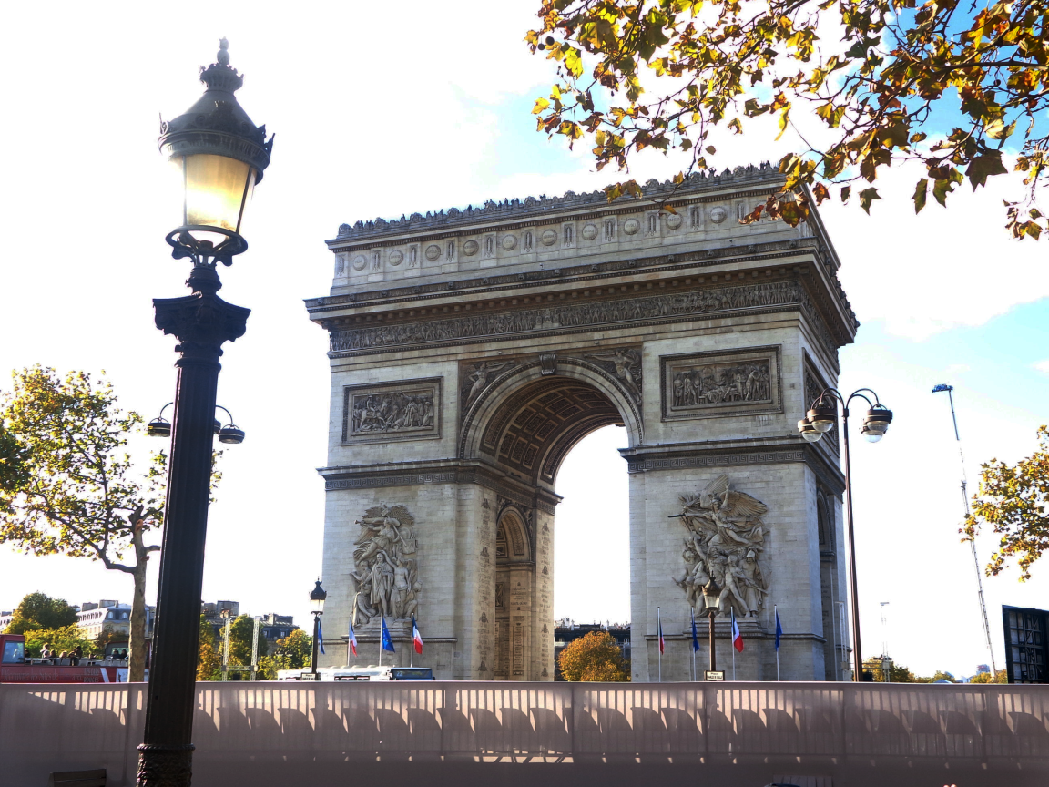
INTERNATIONAL LANGUAGES
France, San Diego, Italy, China, Bermuda, Florida, New York, Spain, Belgium, Quebec
French – Spanish - Japanese

Slide 36
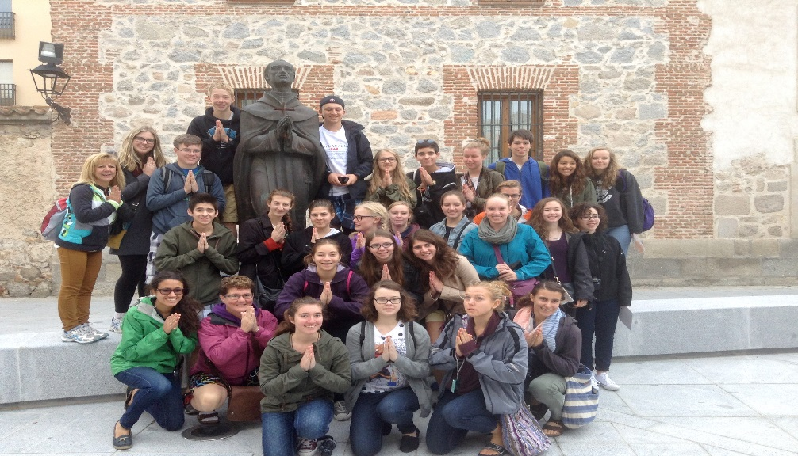
FRENCH, SPANISH & JAPANESE
Language Courses, Tours and
Student Exchanges

Slide 37


CHINA

Slide 38
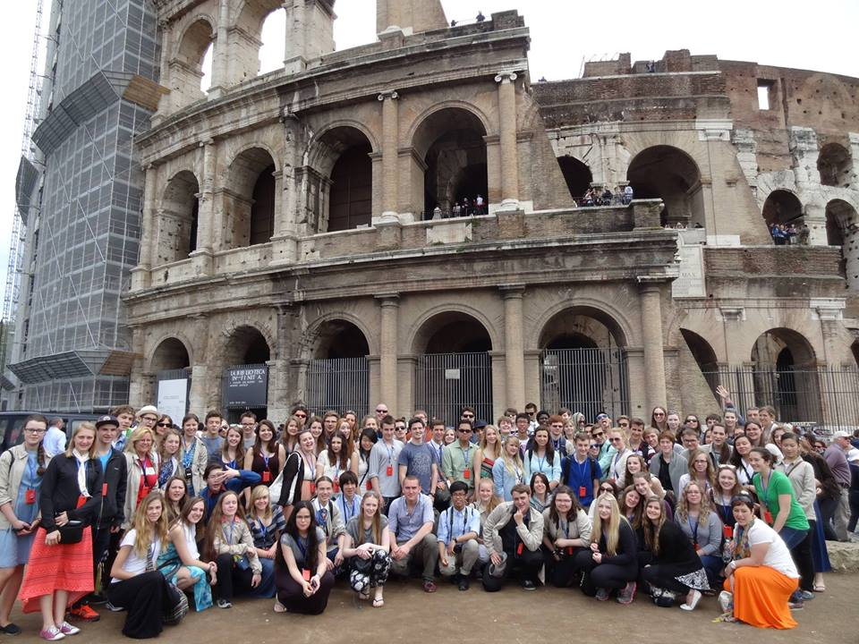
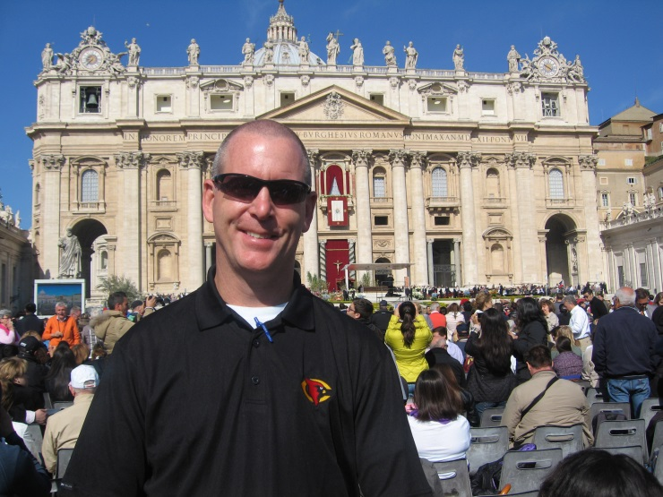
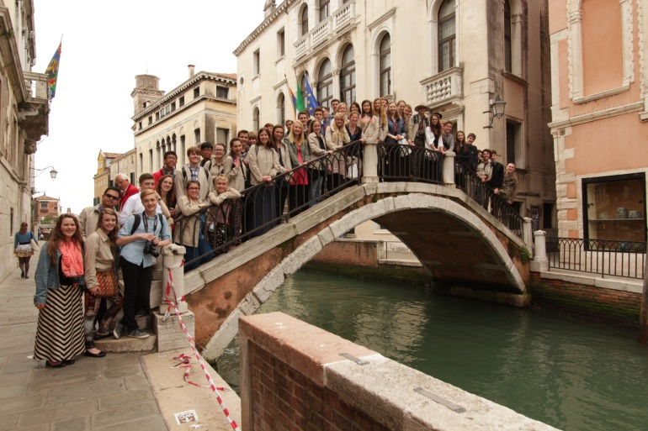
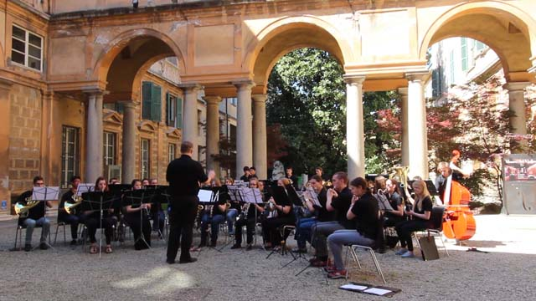
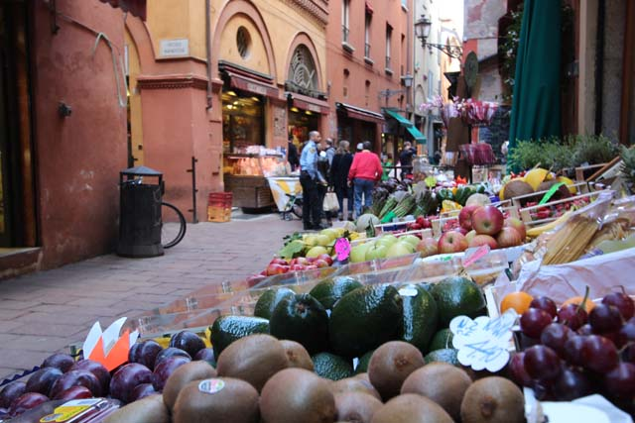
ITALY

Slide 39
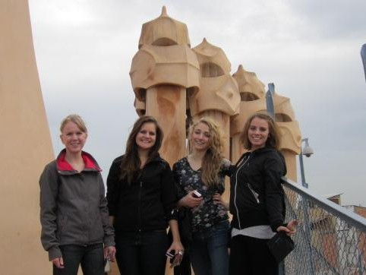
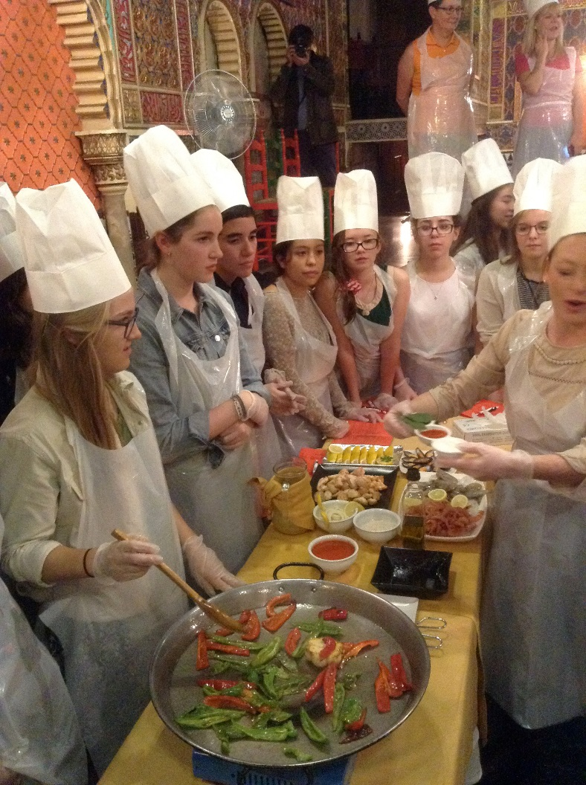
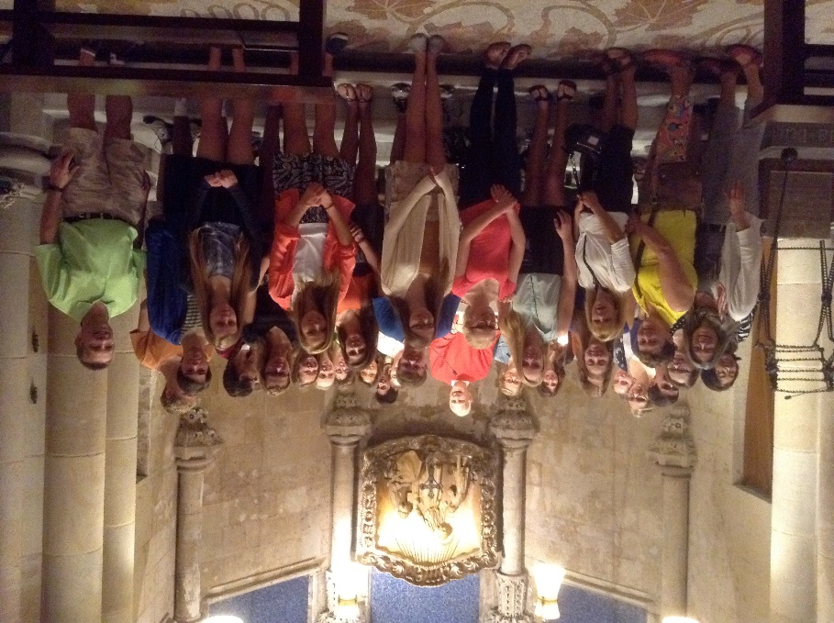
SPAIN & PORTUGAL

Slide 40


Slide 41
